Slide 1
Computer Architecture
A drive-by …
SWEN-440
System Requirements and Architecture Engineering

Slide 2
Fundamentals
Hardware fundamentals shape architectural decisions — knowing the tradeoffs helps you choose wisely
Main components
CPU
  Clock speed → sometimes critical
  Number of cores → affects parallelism
  ISA (x86-64, ARM) → affects which cloud instance types and container images are compatible
Memory
  Available capacity → constrains design decisions (e.g. streaming vs. loading data into memory)
  JRE / DB / cache tuning
Storage
  Types (HDD / SSD / NVMe / cloud / tape) → cost / performance
  IOPS → bottleneck
  Reliability (RAID / distributed FS / redundancy)
  Cloud storage tiers (hot/warm/cold) → cost vs. access latency tradeoff
Bus
  Data movement (bus / interconnect) → bandwidth and latency create bottlenecks between components
Notes:
i.e. Traditional approach is spend weeks on requirements & theory of requirements; then spend weeks on arch and arch theory. We will take a more hands on approach.
Software architecture is rooted in computer architecture – the development of software architecture centers around how to make developing software easier and the process more robust.
Talk about definitions of CPU, Memory, etc.

Slide 3
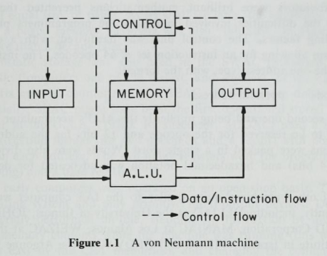
Von Neumann Architecture & Bottleneck
Input
Incoming data & instructions from keyboard, punched cards, network, sensors, files, …
Memory
Stores instructions & data
CPU can extract & execute instructions
ALU (arithmetic logic unit)
Execute calculations (+, -, etc), logic (AND, OR, etc), and instructions
Retrieved from memory
Returns to memory, output
Control unit
Direct the flows of data and instructions
Ensures instruction correct order
Output
Sends result to the world: monitor, printer, network, …
Stored-program architecture proposed in the 1940s
Separates
  Control
  Processing
  Memory
  I/O
Flexible & general purpose
Bottleneck: CPU and memory share a single bus – data and instructions compete for the same channel
Architectural Implications: Cache hierarchies (L1/L2/L3), memory-bound vs compute-bound workloads, shared memory
J. Baer, Computer Systems Architecture, Computer Science Press, p. 5, 1980

Slide 4
Today your software on a computer … looks like this
Application
High level language
OS / Drivers
Runtime compiled libraries
Instruction set
CPU
Memory
I/O
Binary
Circuits / Devices
Transistors, resistors, wiring, …

Slide 5
OS / Drivers: The Abstraction Layer
Application
The OS abstracts hardware resources
System calls are the contract — open(), read(), write() work the same regardless of device
OS manages CPU time, memory, I/O on your app’s behalf
Your app never talks directly to hardware — ever
Drivers abstract specific devices for the OS
One level below the OS — translates generic OS calls into device-specific commands
Swap hardware without rewriting application code
Architecture implication
Each layer hides complexity from the one above — a core architecture principle
Portability constraints and performance ceilings both trace back to these contracts
OS / Drivers
CPU
Memory
I/O
Circuits / Devices

Slide 6
Instruction Set Architecture (ISA)
Application
The contract between software and CPU
Defines the instructions a CPU can execute (add, load, jump…)
Compiled code targets a specific ISA — binary only runs on matching hardware
Common ISAs
x86-64 — servers, desktops, most cloud VMs
ARM — mobile, Apple Silicon, AWS Graviton
Architecture implication
Deployment target affects build pipeline (cross-compile, container-based images)
JVM / .NET CLR use a virtual ISA — runtime translates to native hardware
OS / Drivers
CPU
Memory
I/O
Circuits / Devices

Slide 7
Memory: Process Isolation vs. Shared
Application
Process memory isolation (default)
Each process gets its own private address space
OS prevents one process from reading another’s memory
Crash in one process doesn’t corrupt others
Shared memory (explicit IPC mechanism)
Processes can map a common region — fast, zero-copy communication
Requires synchronization — race conditions if uncoordinated
Architecture implication
Isolation = safer, easier to reason about; shared memory = performance + coordination cost
Ties directly to concurrency quality attributes later in this course
OS / Drivers
CPU
Memory
I/O
Circuits / Devices

Slide 8
I/O: Blocking vs. Non-Blocking
Application
Blocking I/O (synchronous)
Thread waits — doing nothing — until the I/O completes
Simple to code; wastes CPU cycles at scale
Non-blocking I/O (asynchronous)
Thread issues request and moves on; callback/event fires on completion
Higher throughput; more complex control flow
Basis of event-driven architectures (Node.js, nginx, reactive frameworks)
Architecture implication
I/O model shapes your concurrency strategy
I/O is orders of magnitude slower than CPU — it’s almost always the bottleneck
OS / Drivers
CPU
Memory
I/O
Circuits / Devices

Slide 9
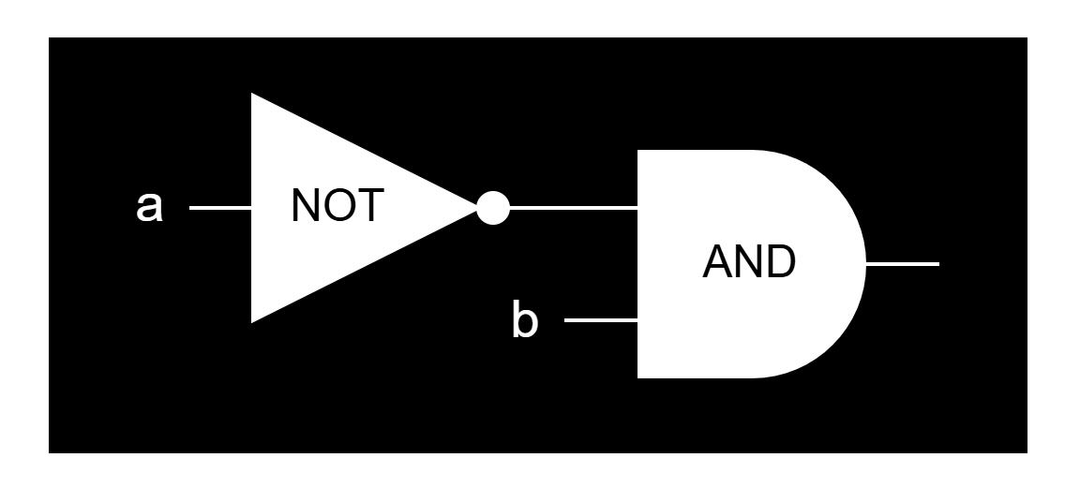
From Code to CPU
Application
if (a == 0 && b != 0)
JVM Bytecode
iload a
ifne SKIP
iload b
ifeq SKIP
Machine Language
CMP [a], 0
JNE SKIP
CMP [b], 0
JE SKIP
Circuit

Slide 10
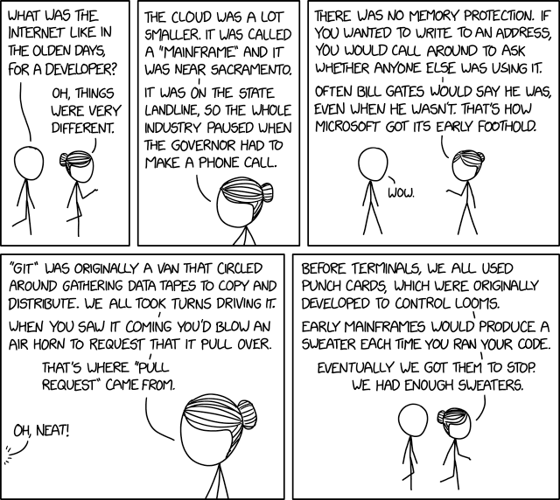
https://xkcd.com/2324/

